Slide 1
Work Integrated Learning
XHAW5112
Group 8
Tebogo Msimanga st10488599
Maditsi Rapelego st10496347
Jupiter Ngwenya st10465627
Onneilwe Malope st10482777

Slide 2
Each team member played a key role — from planning and designing to developing and finalizing the content — ensuring that Empowering the Nation’s website was professional, functional, and aligned with its goal of community empowerment.

Slide 3
Introductionc
Lethabo
Tebogo
Web Developer (Front-End Developer)
Built and coded the actual website using HTML, CSS, and JavaScript.
Converted the wireframes into a fully functional website. Ensured the navigation menu, registration form, and course display worked properly across all devices.
Web Designer (UI/UX Designer)
Designed the wireframes and overall visual layout of the website.
Responsible for creating an attractive and user-friendly interface. We chose suitable colours, fonts, and images that matched the professional and empowering theme of the business.

Slide 4
Jupiter
Onneilwe
Project Manager (Team Leader)
Oversees the entire web development process.
The project manager coordinated all tasks, ensured deadlines were met, assigned roles, and maintained communication between team members. He also managed client feedback from Precious Radebe to align the project with her vision.
Content Developer (Copywriter / SEO Specialist)
Created and organised text and multimedia content for the website.
Wrote and edited all course descriptions, headings, and text on the website. Ensured the content was clear, relevant, and optimized for search engines (SEO).

Slide 5
Problem Statement
Many domestic workers and gardeners in South Africa lack access to professional training.
Empowering the Nation website bridges this gap by offering affordable, practical courses and making it easy to learn about the course, calculate fees, and enrol in training programmes.

Slide 6
Website Overview
Our website includes:
Home Page: Introduction and mission
About Page: Founder story and goals
Courses: 6-Month and 6-Week training options
Purchase Page: Fee calculator with discounts and VAT
Success Page: Feed back to the user
Contact Page: Maps, phone, and email information

Slide 7
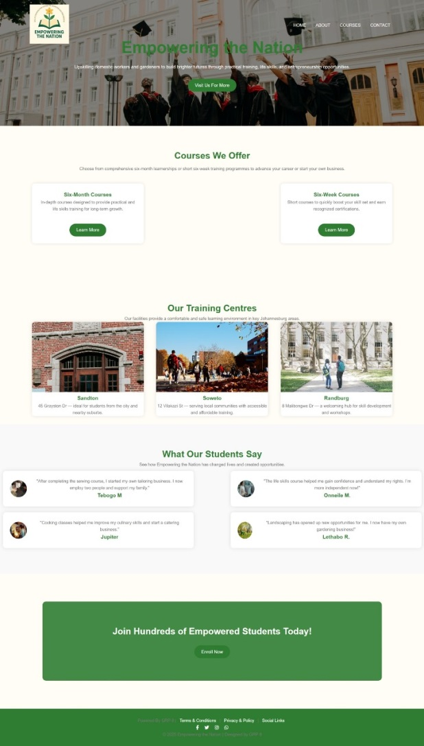
Home Page
Mission: To uplift domestic workers and others through practical training and life skills.
Courses Offered: Promotes both six-month partnerships and short courses for career advancement or starting a business.
Training Centres: Lists three locations in Johannesburg (Sandton, Soweto, Randburg) with brief descriptions.
Student Testimonials: Features quotes from students (Tebogo M., Jupiter, Onnelle M., Lethabo R.) who started their own businesses or gained confidence after taking courses.
There is a call to action: "Explore More."

Slide 8
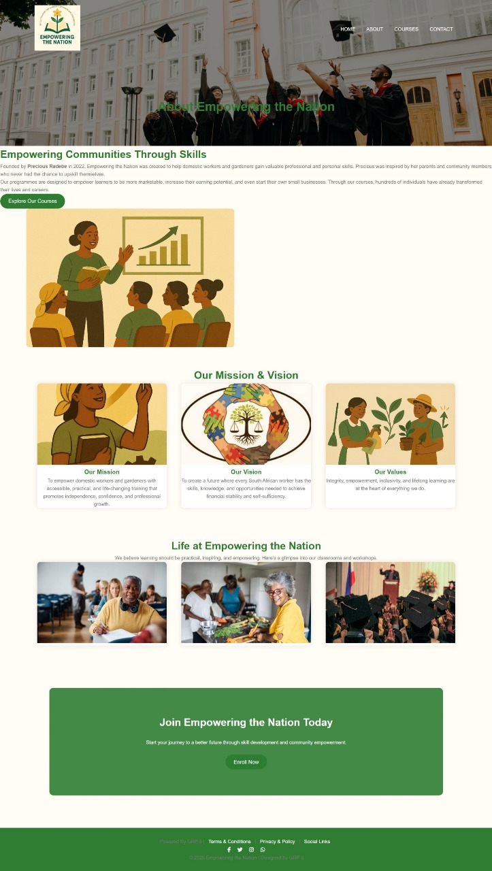
About Us Page
This page provides the background, mission, and vision of "Empowering the Nation."
Founder & Origin: Founded by Precious Radebe in 2022, inspired by her parents and community members to help domestic workers gain valuable skills.
Programme Goal: Designed to make learners more marketable, increase their earning potential, and enable them to start their own small businesses. It highlights that hundreds have already transformed their lives.
Mission & Vision:
  Mission: To provide practical training that promotes independence, confidence, and professional growth.
  Vision: To create a future where every South African worker has the skills and opportunities for financial stability and self-sufficiency.
Core Values: Integrity, empowerment, inclusivity, and lifelong learning.
Life at the Organisation: Mentions that learning is practical, inspiring, and empowering, with a promise of a "glimpse" into classrooms and workshops.
The page ends with a call to action: "Enrol Now."

Slide 9

Courses Page
This page helps users choose between the two main programme types.
Six-Month Courses: Described as comprehensive training for entrepreneurship or employment.
Six-Week Short Courses: Described as quick, focused courses for practical skills and certifications.
Each path has a button to "View" the respective courses.

Slide 10
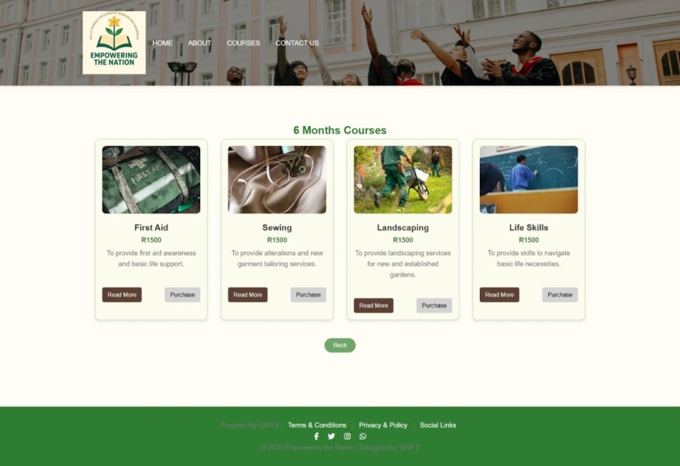
6 Months Courses
This page lists the four comprehensive courses in the 6-month programme, each priced at R1500.
First Aid: For first aid awareness and basic life support.
Sewing: For alterations and new garment tailoring.
Landscaping: For servicing new and established gardens.
Life Skills: To navigate basic life necessities.
Each course has a "Read More" and "Purchase" option, and there is a "Back" button at the bottom.

Slide 11
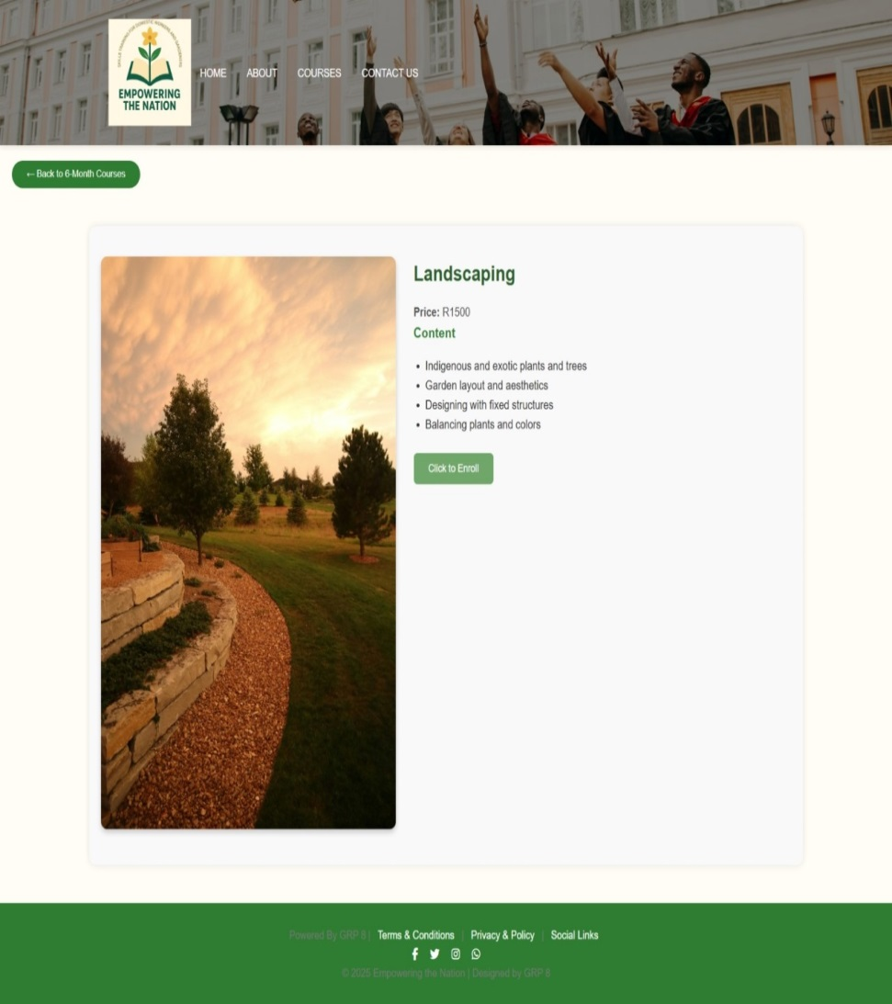
6 Months Course Details
This is a detailed page for the Landscaping course from the 6-month programme.
Course: Landscaping
Price: R1500
Content Covered: Working with indigenous/exotic plants, garden layout and aesthetics, designing with structures, and balancing plants/colors.
It includes a "Back to 6 Month Courses" link and a "Click to Email" button to book.
Image (8).jpeg: 6-Month Courses
This page lists the four comprehensive courses in the 6-month programme, each priced at R1500.

Slide 12
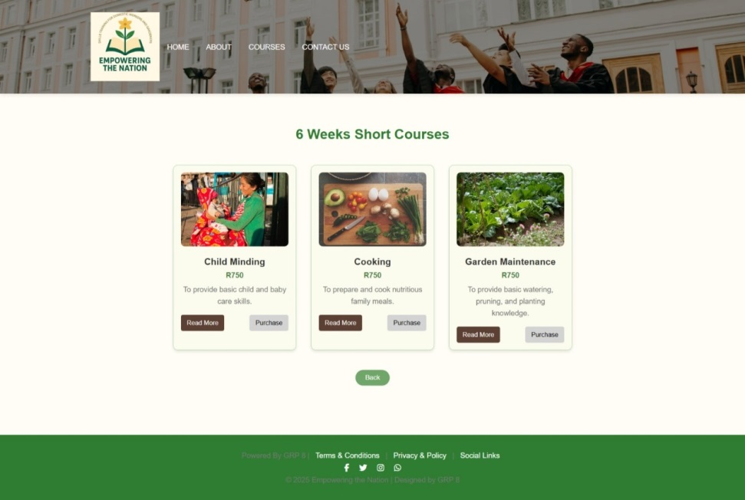
6 Weeks Courses
This page lists three short courses, each priced at R750.
Child Minding: Focuses on basic child and baby care skills.
Cooking: Teaches how to prepare and cook nutritious family meals.
Garden Maintenance: Provides basic knowledge on watering, pruning, and planting.
Each course has a "Read More" and "Purchase" option.
The page ends with a "Book" button and standard footer information.

Slide 13

6 Weeks Course Details
Course: Cooking
Price: R750
Content Covered: Nutritional requirements, food types, meal planning, recipes, and meal preparation/cooking.
The main call to action is a "Click to Enrol" button to book the course.

Slide 14
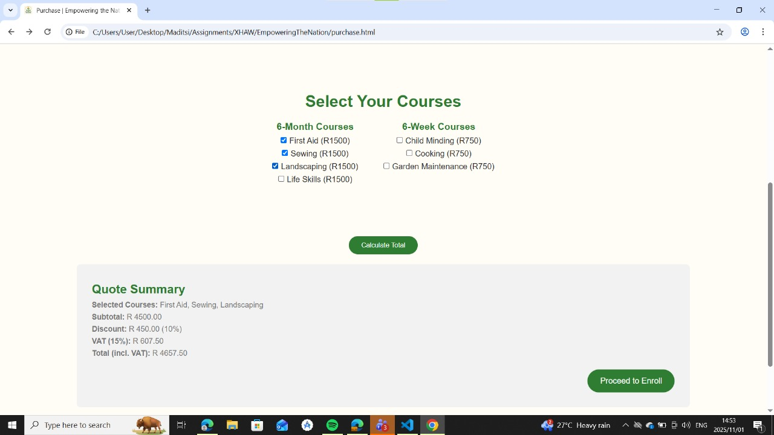
Course Purchase Page
This is a course selection page with a built-in calculator.
6-Month Courses: First Aid, Sewing, Landscaping, Life Skills (R1500 each).
6-Week Courses: Child Minding, Cooking, Garden Maintenance (R750 each).
The purpose is for users to select their courses and see a calculated total cost.

Slide 15

Registration Form
The Empowering the Nation registration page allows users to easily enrol for one or more courses online. It includes fields for the user’s full name, email, and phone number, as well as checkboxes to select courses such as First Aid, Sewing, and Life Skills. The page features a clean, professional design with a “Submit” button to send registration details directly to the system. This form simplifies the enrolment process, ensures accurate data collection, and supports automatic discounts for multiple course selections.

Slide 16
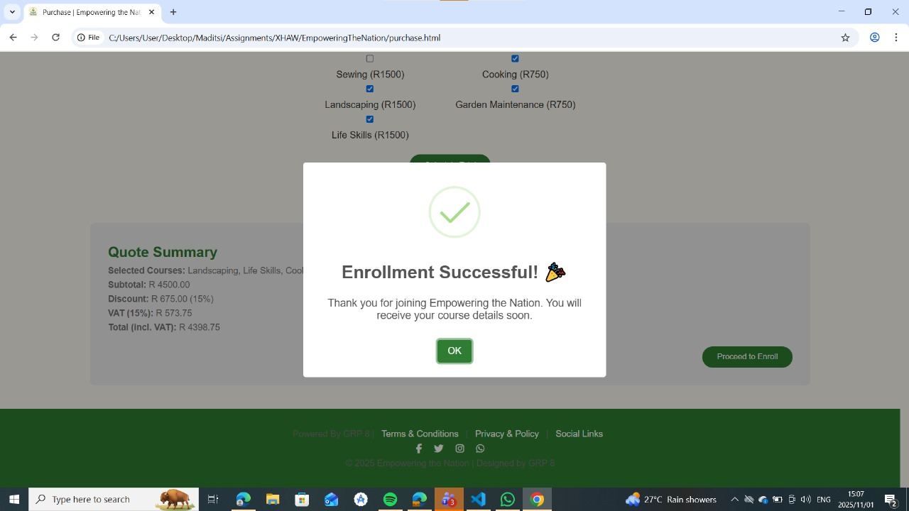
Success Page
This is a payment confirmation and invoice page for "Empowering the Nation."
Selected Courses: Landscaping, Life Skills, and (likely) Cooking.
Cost Breakdown:
  Subtotal: R 4500.00
  Discount: R 675.00 (15%)
  VAT (15%): R 573.75
  Total Amount Due: R 4398.75
Status: Enrolment is confirmed as successful.
Next Steps: The user can click "OK" or "Proceed to Email" to presumably receive their course details via email.

Slide 17
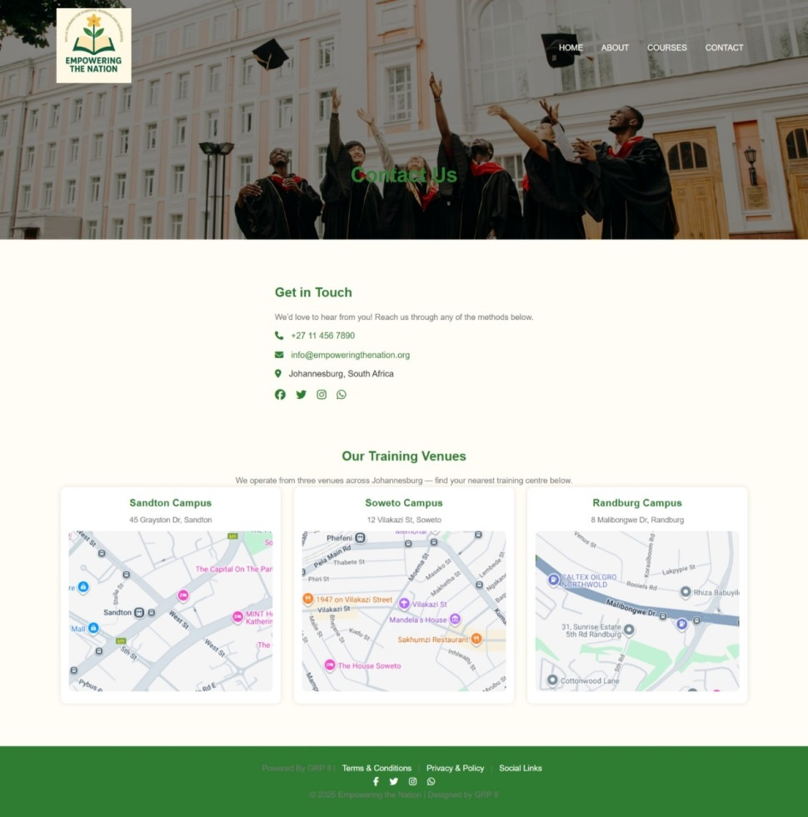
Contact Page
This is a "Get in Touch" page with contact details and detailed venue information.
Contact Info: Phone number (+27 11 456 7890), email, and general location (Johannesburg).
Training Venues: Provides specific addresses and nearby landmarks for three campuses: Sandton, Soweto, and Randburg.

Slide 18
How the system is going to solve the problem
The Empowering the Nation website directly addresses the challenges faced by Precious Radebe’s training business by creating a professional and accessible online presence. The website provides a digital platform where potential learners, domestic workers, gardeners, and employers can easily access information about the available courses, prices, and benefits.
By showcasing both six-month and six-week training programmes, the website promotes the organization’s services to a wider audience beyond the local community.
Through the website, customers can conveniently browse courses, read detailed descriptions, and request information or quotations online without having to visit the training centre in person. The built-in functionality for submitting requests and receiving quotes streamlines communication, making it easier for Precious to manage enquiries and respond to potential clients efficiently.
Additionally, the website’s structure supports multiple course selections and can automatically apply discounts based on the number of courses chosen—ensuring fair and transparent pricing.
The professional design, use of suitable images, colours, and fonts reinforces the credibility of the business and reflects its goal of empowerment and skill development. By making course details and registration easily available online, the website helps increase enrolment, improves marketing visibility, and supports Precious’s mission to uplift her community by providing accessible skills training.

Slide 19
System Requirements
Functional Requirements
1.Course Display
The website displays a list of all available six-weeks and six-months courses, including course names, descriptions, prices and images
2.Course Selection & Discount Application
Users can select multiple courses, and the system calculates discounts automatically
3.Quote Request & Submission
Customers are able to submit a quote or request more information about selected courses through the website
4.Navigation
The website has a working navigation links that allows users to move easily between pages
5.User Registration and Enrolment
User must be able to fill in a registration form with their name, email, and phone numbers and select one or more courses to enrol in
6.Social Media Integration
Links to social media platforms are included for external communication and marketing

Slide 20
Non Functional Requirements
Usability
The website is easy to navigate, with clear labels, readable fonts, and a consistent layout across all pages.
2.Perfomance
Pages load quickly, and all links and buttons responds promptly to users actions
3. Reliability
The system can handle multiple users accessing course information or submitting forms without errors
4.Security
User data is securely stored and protected from unauthorised access
5.Compatibility
The website works correctly or different devices and across major web browsers
6.Maintance
The website is easy for administrators to update, such as adding new courses or changing prices, without major technical skills
7.Availability
The website is accesseble to users at all times to allow enrolments and course browsing without downtime
8.Design & Consistency
Colour, images, and fonts reflects a professional and empowering brand image aligned with the organisation’s goals

Slide 21
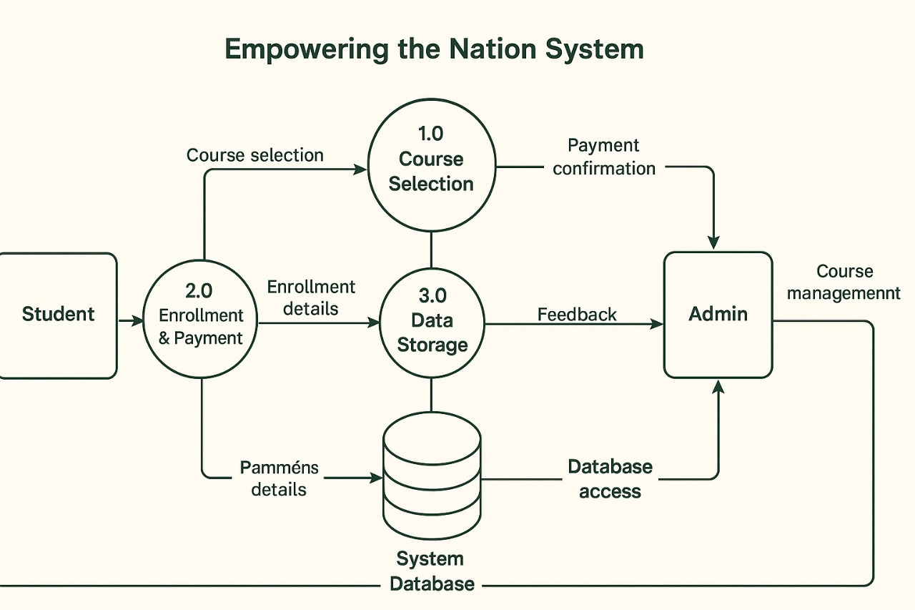
Data Flow Diagram

Slide 22
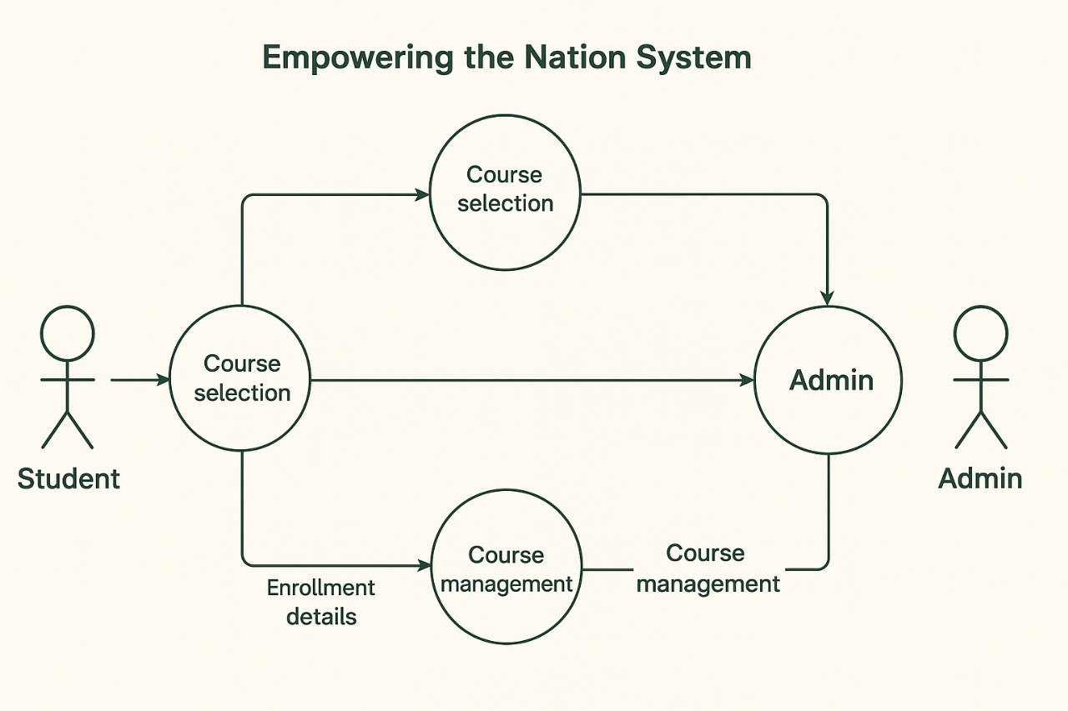
Use Case Diagram

Slide 23
Demonstration of Website
The Empowering the Nation website demonstration showcases how users can easily navigate and interact with the platform. The homepage introduces the organization and allows visitors to choose between six-month and six-week training programmes. Each course page displays detailed information, including course titles, images, prices, and short descriptions, along with buttons to read more or purchase a course. The demonstration highlights the website’s user-friendly layout, consistent design, and accessible navigation through the Home, About, Courses, and Contact pages. It also shows how users can request more information, view discounts when selecting multiple courses, and connect with the organization through social media links in the footer. Overall, the demonstration illustrates how the website effectively promotes the business, simplifies communication with customers, and encourages online course enrolment

Slide 24
Demonstration of Mobile App
The Empowering the Nation mobile app demonstration showcases how users can access the same training services conveniently from their smartphones. The app features a simple and responsive interface where users can browse available six-week and six-month courses, view prices, and read short course descriptions. It also demonstrates how customers can select multiple courses, automatically receive discounts, and submit requests for quotations or additional information directly through the app. The demonstration highlights easy navigation, quick access to contact details, and notifications for updates or promotions. Overall, the app provides a practical and accessible way for learners and employers to engage with the organization anytime, anywhere.

